Slide 1

Install Docker
https://download.docker.com/mac/stable/Docker.dmg

Slide 2
Install Pirana + XQuatz
pirana_2.9.8_MacOSX.dmg
Xquartz
https://www.xquartz.org/
https://dl.bintray.com/xquartz/downloads/XQuartz-2.7.11.dmg

Slide 3

Install git
https://www.liaoxuefeng.com/wiki/896043488029600/896067074338496
https://sourceforge.net/projects/git-osx-installer/
https://www.worldhello.net/gotgit/01-meet-git/040-install-on-mac.html

Slide 4
Install docker version of NONMEM7.4.3+PsN4.8.1
git clone https://github.com/kinginsun/nonmem.git

Slide 5
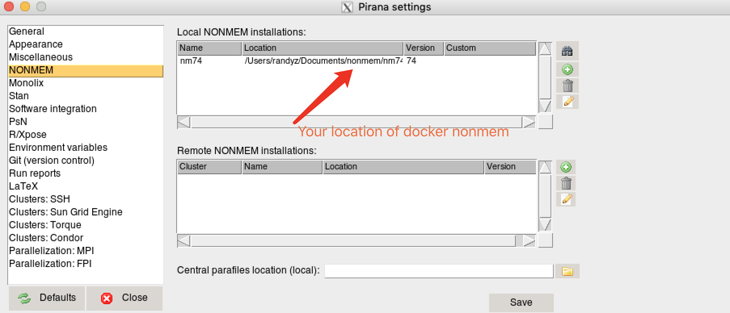
Integrate with Pirana

Slide 6
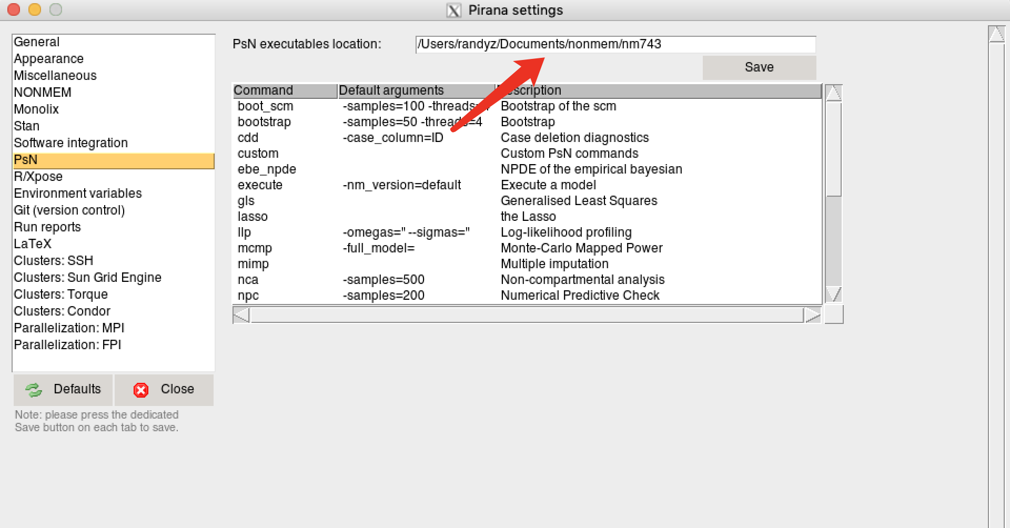
Integrate with Pirana

